Slide 1


FUNDAMENTALS OF DEVELOPMENT
Instructor: Beck Johnson Week 1

Slide 2

Introductions
Who are you? Who am I?
What do you do/study/etc?
What is your experience with web development?
Do you have related skills like Photoshop, wireframing, email marketing, etc?
What are you hoping to get out of this class?

Slide 3

CLASS SCHEDULE
Five sessions over six weeks
Mondays from Nov 5 to Dec 10, at 6:30-9:30 pm
No class week of Thanksgiving
10 minute break somewhere in the middle
No grades, no tests
Questions and feedback highly encouraged!

Slide 4

course OVERVIEW
Basics of HTML and CSS
Using CSS to style web pages
Website structure, navigation, and file organization
Preparing images for use on the web
Overview of related technologies (Javascript, Git)

Slide 5

today
Code editors
Basic HTML
Basic CSS – font styling, colors, alignment
Build your first web page!

Slide 6
ODDS & ENDS
beckjohnson.com
Slides, sample files, “homework", and interesting links will be posted here

Slide 7

Overview OF A WEBSITE

Slide 8



CONTENT, DESIGN, & CODE
Content
Most important part of any website
HTML
Design
Critical to the best user experience
CSS
Code
Brings content and design to life
Javascript

Slide 9

CONTENT
What am I presenting?
TEXT
Articles
Links
Lists
MEDIA
Images
Videos
Audio
Content is entered using HTML

Slide 10
DESIGN
What is the experience?
USER EXPERIENCE
GRAPHIC DESIGN
Layout
Navigation
User flows
Colors
Fonts
Backgrounds
Design is done with CSS

Slide 11

CODE EDITING TOOLS

Slide 12






HTML EDITORS
VS Code
Brackets
Atom
Sublime Text
Coda

Slide 13
PRACTICE, STUDY, PRACTICE
HTML EDITORS
HTML is just text
You can right-click and select "View Source" on any webpage to see how the developer made it

Slide 14

DEVELOPER TOOLS
Chrome/Firefox
Right-click anywhere on the page > Inspect
OR hit the F12 key
Safari
Open Preferences > Advanced > Show Develop menu
Right-click > Inspect Element
Internet Explorer
F12 key

Slide 15
Let’s try it

Slide 16
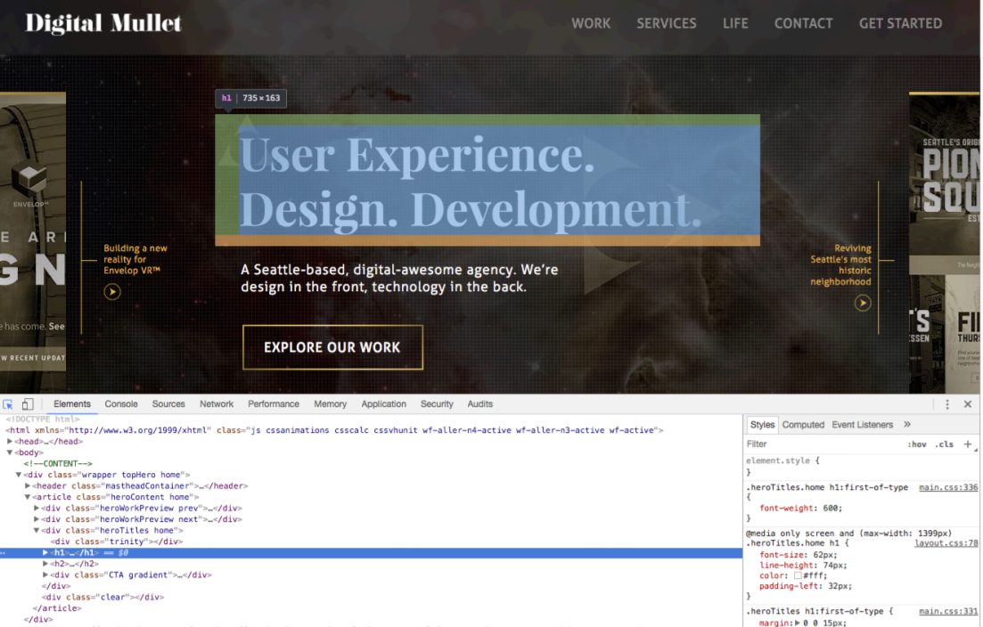
DEVELOPER TOOLS

Slide 17

WEB BROWSERS
You can experiment directly in the browser using dev tools before making permanent changes
You can modify both HTML and CSS
Any changes disappear when you refresh the page – copy to a local file if you want to keep them!

Slide 18
<html>
HTML DOCUMENTS

Slide 19
HTML is for content
The first step to creating a web page is deciding which content you want to share.
What is the site about?
Write out your copy and find or create images
Don’t worry how it looks at first, just get the content on the page

Slide 20
HTML is for content
After your content is in place, use HTML to organize and format it.
This is similar to creating a document outline in MS Word
Web browsers read HTML code and interpret it as formatted text
Don’t worry about how it looks just yet!

Slide 21

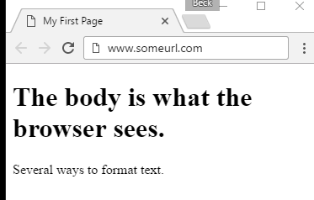
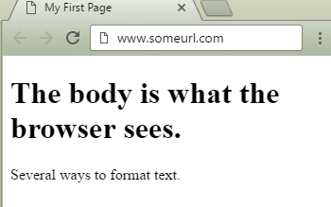
HTML DOCUMENT
<!doctype html>
<html>
<head>
<title>My First Page</title>
</head>
<body>
<h1>The body is what the browser sees.</h1>
<p>Several ways to format text.</p>
</body>
</html>

Slide 22
HTML Elements
HTML elements (also called tags) are contained in <> brackets
HTML tags have an opening tag and a closing tag
<tag>Content goes in here</tag>

Slide 23
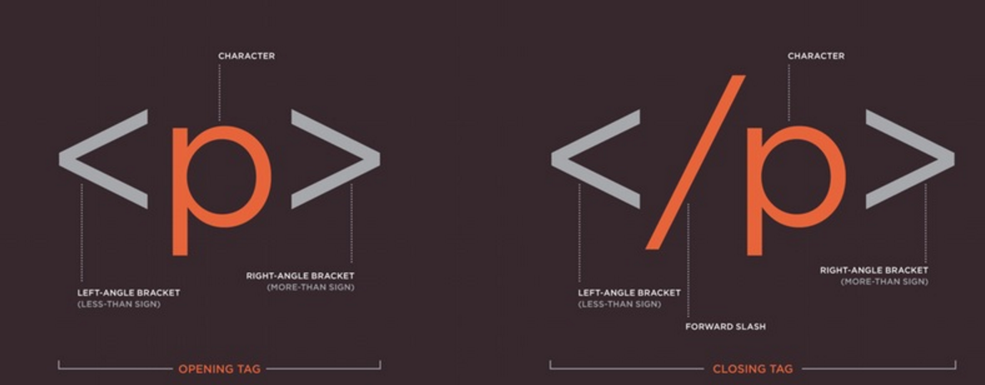

HTML Elements
20

Slide 24
HTML RULES
Tags are written in lowercase
<a> not <A>
Tags must be closed
<p>Text in here.</p>
<div>Content in here.</div>
A few are “self closing”
<img/>

Slide 25
DOCTYPE
<!doctype html>
The very first thing in any HTML document
Tells the browser what version of HTML the document is written in (this one is HTML5)
If you don’t specify what version to use, the browser will guess…

Slide 26
DOCTYPE
These old doctypes are not commonly in use anymore:
<!doctype html PUBLIC "=//W3C//DTD XHTML 1.0 Strict//EN" "http://www.w3.org/TR/xhtml1/DTD/xhtml-strict.dtd">
<!doctype html PUBLIC "=//W3C//DTD HTML 4.01 Transitional//EN" "http://www.w3.org/TR/xhtml1/DTD/transitional.dtd">

Slide 27
HTML DECLARATIOn
<html>
The top line after <doctype>
declaration.
Tells the browser “This is where everything starts!”
<html><!-- everything else --></html>

Slide 28
<!--HTML COMMENTS-->
<!-- Comments are great -->
Are not visible to the user in their browser
Great for leaving notes for yourself or other developers
Can be seen in “view source” (right-click in a browser -> View Source)

Slide 29
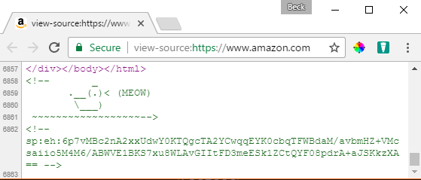
<!--HTML COMMENTS-->
Sometimes they don’t really have a point…

Slide 30
HEAD ELEMENT
<head></head>
Holds information about the document that is (mostly) not visible to the user
Any content other than title is not shown on the page
Can contain CSS and Javascript
Don’t mix this up with “headings” such as <h1>
<head>
<!-- metadata and resources -->
</head>

Slide 31
TITLE TAG
<title>My First Page</title>
Displays in the browser tab
Required inside <head>
<head>
<title>My First Page</title>
</head>

Slide 32
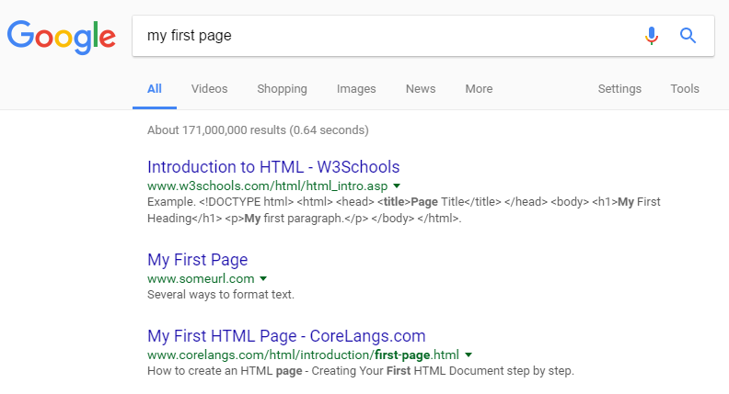
TITLE TAG
<title>My First Page</title>
Also the name of the page when page is bookmarked
The title for the page in search results on Google

Slide 33
BODY ELEMENT
<body></body>
The part of the HTML document that’s visible to the user
Contains all content of the document, such as tags, links, images, text, etc.
<head>
<title>My First Page</title>
</head>
<body>
<!-- all my sweet content -->
</body>

Slide 34
MAJOR BODY ELEMENTS
Headings for dividing up your page and content
Paragraphs of text
Bulleted, ordered, unordered lists
Images
Links to other pages, websites, or resources.

Slide 35
HEADINGS
<h1>My Page Header</h1>
Headings range from most important to least important
<h1> to <h6>
Search engines use <h1> to determine important information about the page

Slide 36
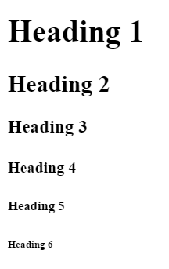
HEADINGS
<h1>Heading 1</h1>
<h2>Heading 2</h2>
<h3>Heading 3</h3>
<h4>Heading 4</h4>
<h5>Heading 5</h5>
<h6>Heading 6</h6>

Slide 37
PARAGRAPHS
<p>Hi! I'm a paragraph!</p>
Browsers automatically add space around <p> elements (although this can be changed with CSS)

Slide 38
formatting
<em> indicates emphasis
By default, this displays as <em>italic</em>
<strong> indicates importance
By default, this displays as s<strong>bold</strong>

Slide 39
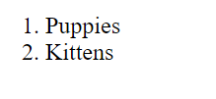
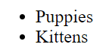
List Elements
<ul>
<li>Puppies</li>
<li>Kittens</li>
</ul>
Unordered lists <ul> appear in the browser with bullets

Slide 40
List Elements
<ol>
<li>Puppies</li>
<li>Kittens</li>
</ol>
Ordered lists <ol> appear in the browser with numbers

Slide 41
List Elements
<ul>
<li>Puppies</li>
<li>Kittens</li>
</ul>
Both unordered and ordered lists can only contain list items <li> directly

Slide 42

IMAGES
<img src="kitten.jpg" alt="Cute kitten" />
Images are “self-closing" (meaning they end with />) and have two required attributes:
src is a path to where the file lives (local or external)
alt is a description of the image (used for screen readers, search engines, etc)

Slide 43
IMAGES
<img src="kitten.jpg" alt="Cute kitten"
height="200" title="Ollie" />
height and width resize images and ensure the page
doesn't jump
title is shown as a tooltip in some browsers when you hover your mouse over the image

Slide 44
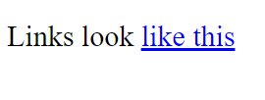
Links with the anchor tag
<a href="http://google.com">Google</a>
The <a> element defines an “anchor tag” or link
Anything inside <a> is clickable – this can be text, an image, or any other valid HTML
The browser will automatically underline links and turn the text inside blue

Slide 45
Some <A>ttributes
<a href="http://google.com" title="Search" target="_blank">Google</a>
href is the URL where the link should send the user
title appears as a tooltip when you mouse over the link. It's read aloud by screen readers
target="_blank" forces the link to open in a new tab

Slide 46
Url-scuse me?
URL stands for “Uniform Resource Locator”
Uniform
because it is a global standard
Resource Locator
because that’s what an URL does – it locates a resource that lives on the internet

Slide 47
Relative file Paths
Relative paths are URLs that go to a resource in relation to the page you’re on
Resources “local” to you should all be relative paths (your images, HTML documents, fonts, CSS, and JS files)
<a href="other-page.html">Link to another page on my website</a>
<img src="image.gif" /> (image is in same folder)
<img src="../images/image.gif" /> (image is in parent folder)

Slide 48
absolute FILE PATHS
Absolute paths are URLs that start with http
<a href="http://google.com">Ubiquitous search engine</a>
These documents are not hosted by you, so if someone renames or deletes the file, your link will be broken

Slide 49
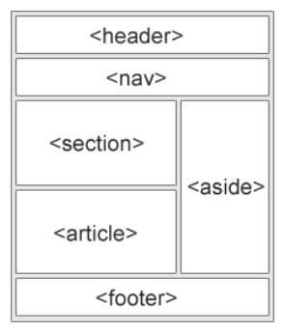
layout
<nav> indicates that everything inside is related to navigation
<section>, <article> and <main> are used to define content sections
<footer> wraps footer content (for example copyright)

Slide 50
layout
<nav>, <section>, <article>, <main> and <footer> separate content into logical sections, and they don’t visually change the page until you apply CSS
But, they help organize content and allow search engines to understand the structure of your page

Slide 51
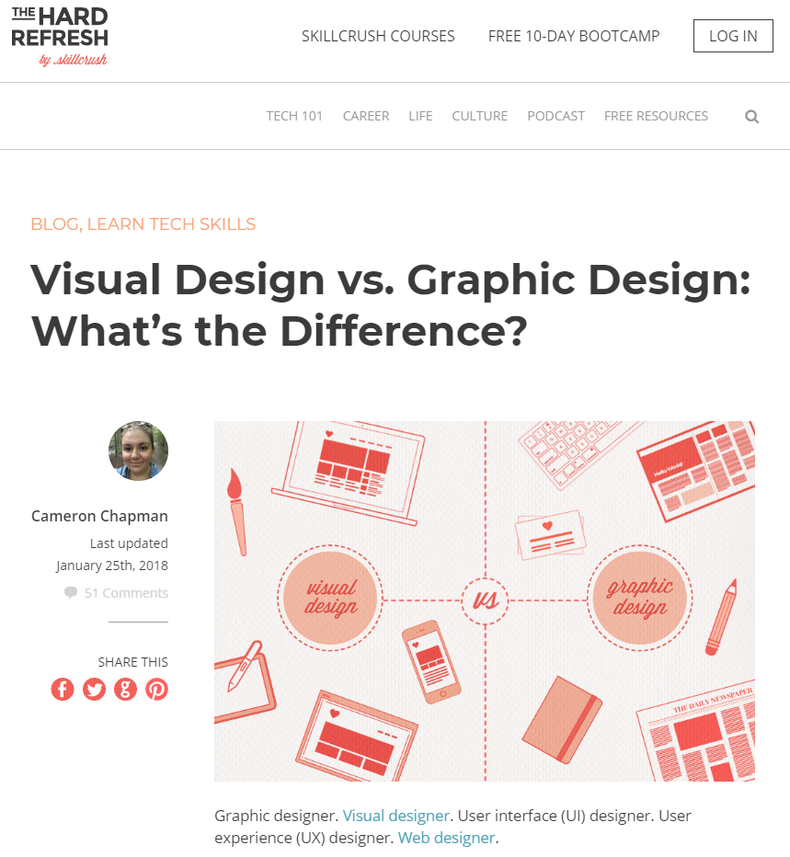

Slide 52
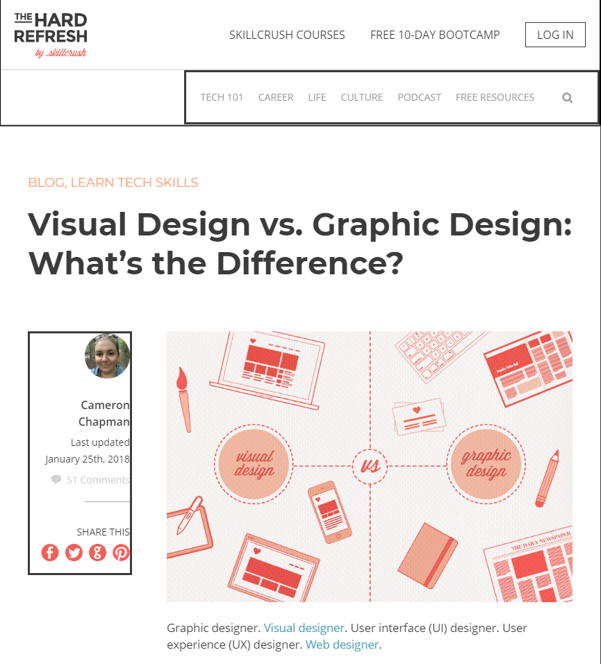
header
nav
section
aside

Slide 53
<!doctype html>
<html>
<head>
<title>The Difference Between Visual Design and Graphic Design</title>
</head>
<body>
<header>
<img src="logo.jpg" alt="The Hard Refresh Logo" />
<nav>
<ul>
<li><a href="/courses.html">Skillcrush Courses</a></li>
<li><a href="/bootcamp.html">Free 10-Day Bootcamp</a></li>
</ul>
</nav>
<nav>
<ul>
<li>Tech 101
<ul>
<li><a href="/html.html">HTML & CSS</a></li>
<li><a href="/design.html">Design</a></li>
</ul>
</li>
<li><a href="/career.html">Career</a></li>
</ul>
</nav>
</header>
<section>
<h1>Visual Design vs. Graphic Design: What’s the Difference?</h1>
<aside>
<img src="Cameron-chapman.jpg" alt="Headshot of Cameron Chapman" />Cameron Chapman
</aside>
<img src="visual-vs-graphic.jpg" alt="Visual vs graphic design" />
<p> Graphic designer. <a href="/design.html">Visual designer</a>. User interface (UI) designer. User experience (UX) designer. <a href="/design.html">Web designer</a>.</p>
</section>
</body>
</html>

Slide 54
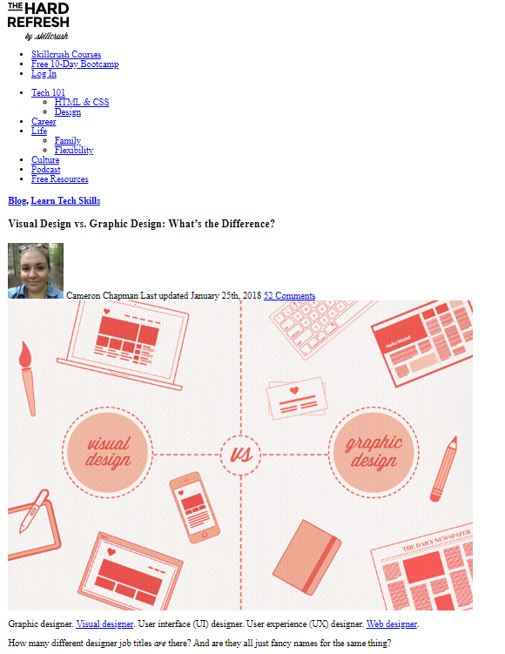

Slide 55
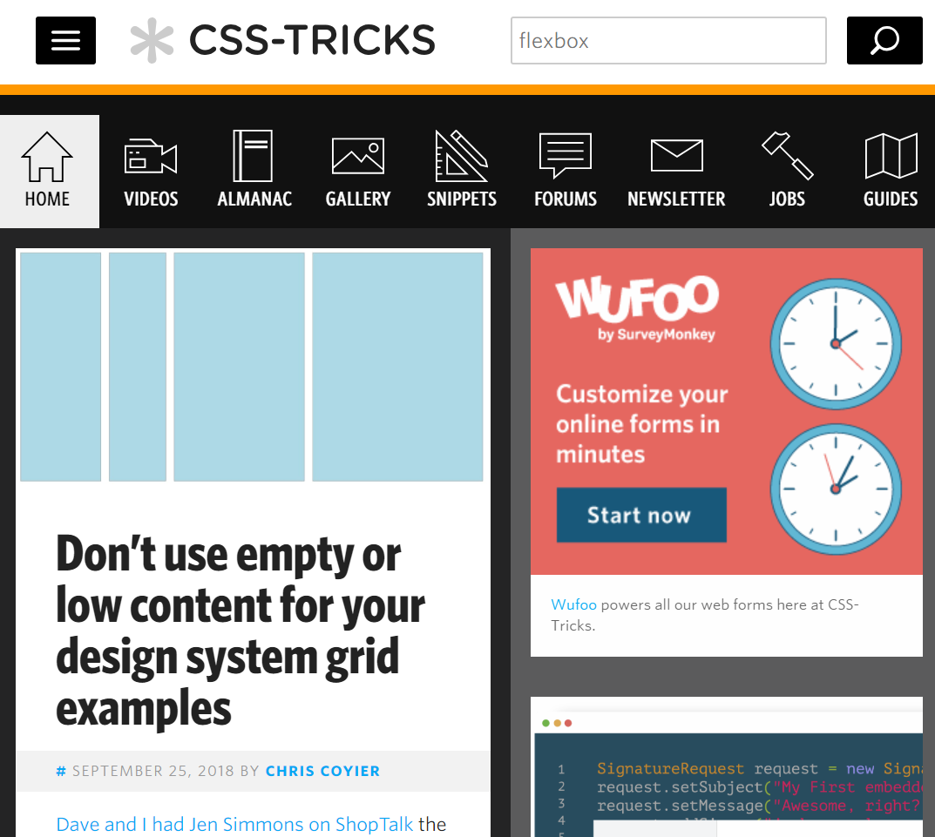
header
nav
aside
main

Slide 56
PRACTICE TIME!

Slide 57
Assignment
Create a website that about something that interests you
At least two pages that are linked to each other
Use some heading tags and at least one paragraph
Use at least one list
Show at least two images
Add one HTML comment
Validate your website by copying it into the form here: https://validator.w3.org/#validate_by_input

Slide 58


Slide 59
CSS is for presentation
After your content has been created and formatted with HTML, use CSS to change how it is presented
This is similar to changing margins, font color, or font family in MS Word (it doesn’t change how things are structured, just how they look)

Slide 60
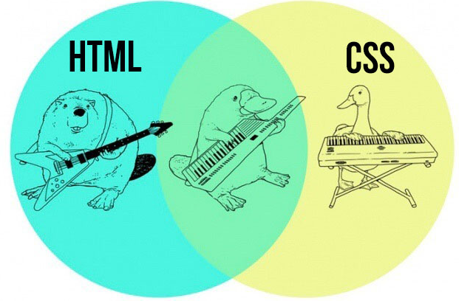
html + CSS = WEBPAGE

Slide 61
CASCADING STYLE SHEETS
CSS is a language for specifying how a website is visually presented to users
Allows us to override the browser’s default presentation styles with a custom version
Provides consistent and scalable ways to style single elements, single pages, or entire websites

Slide 62
Css goes where?
CSS is a different type of language than HTML, and has its own syntax
CSS can go directly in your HTML file, inside a <style></style> element
You can also create a .css file that can be linked to your HTML page
Styles inside a .css file don’t need a <style></style> tag because the whole file is assumed to be in the CSS language

Slide 63
CSS: FAIR WARNING
There is A LOT you can do with CSS
We won’t get anywhere close to covering everything!
We will learn CSS for text styles, colors, positioning, layout, and a couple of extras

Slide 64
ANATOMY OF A CSS RULE
selector { property: value; }
selector is the thing you want to style
property is the attribute you want to style
value is how you want to style it
Values always end in semicolons (;)

Slide 65
ANATOMY OF A CSS RULE
<style>
p {
color: blue;
}
</style>
"All paragraphs will have blue text "

Slide 66
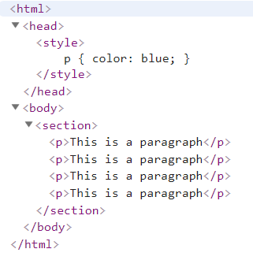
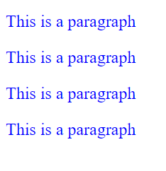

ANATOMY OF A CSS RULE

Slide 67
EXAMPLE CSS RULE
p { color: blue; }
selector is p (all <p> tags in the HTML page)
property is color
value is blue (many color names are supported, or use the hex code #0000ff)
Notes:
Look up hex code for blue

Slide 68
EXAMPLE CSS RULE
p {
color: blue;
font-size: 14px;
}
Multiple properties can be defined for a single selector, each separated by a semicolon (;)
Notes:
Look up hex code for blue

Slide 69
{ } Common font Properties
font-weight: normal by default – can also be bold, or values like 100, 200, etc. (depending on the typeface).
100 - Thin
200 - Extra Light (Ultra Light)
300 - Light
400 - Normal
500 - Medium
600 - Semi Bold (Demi Bold)
700 - Bold
800 - Extra Bold (Ultra Bold)
900 - Black (Heavy)

Slide 70
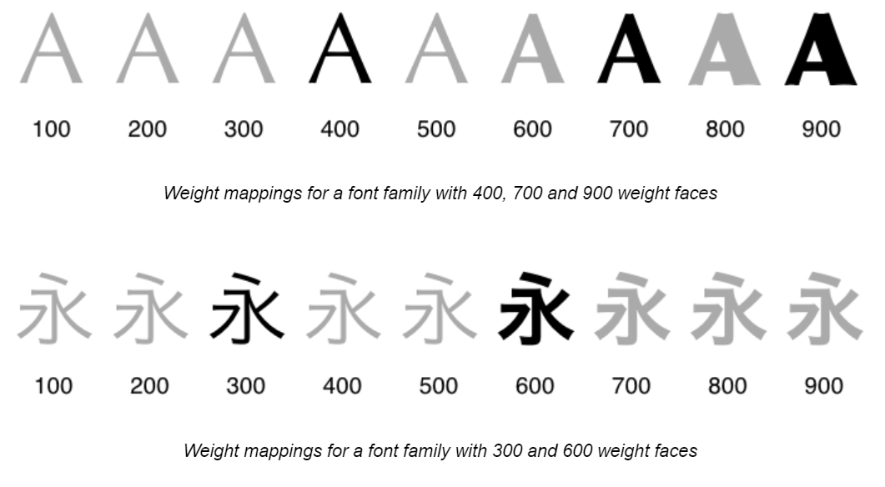
{ } Common font Properties

Slide 71
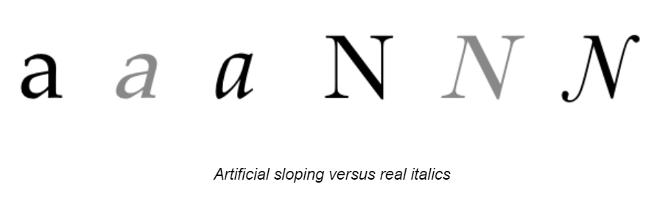
{ } Common font Properties
font-style: normal by default – can also be italic or oblique.
ul { font-style: italic;
}
If an italic version of the font is not installed, the browser will artificially slope the normal typeface.

Slide 72
{ } Common font Properties
font-family: the name of a typeface installed on the user's computer
p { font-family: Arial, Helvetica, sans-serif; }
Typically the value is a list of acceptable fonts that can used
Goes down the list until a font file is found, or until one of the default options is used instead (serif, sans-serif, cursive, fantasy, or monospace)
The W3 has a list of “web safe” fonts that most people will have installed locally

Slide 73
{ } Common font Properties
font-size: how big the font should be
The value is a number representing the size of that element’s text in ems (em) or pixels (px)
p { font-size: 14px; }
Notes:
Website live example

Slide 74
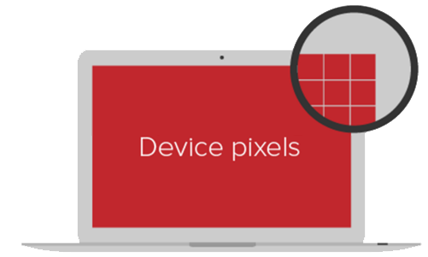
{ } Quick aside about units
The two standard units for sizing in CSS are px and em
px stands for pixels, but it won’t be actual device pixels
Devices with more PPI (pixels per inch) may use several device pixels when displaying 1px
1px should look like ~1/96 inch on a device with a pixel density of 96dpi, held at arm’s length
That means that 1px should always look "about the same“ even though it’s not technically an absolute size

Slide 75
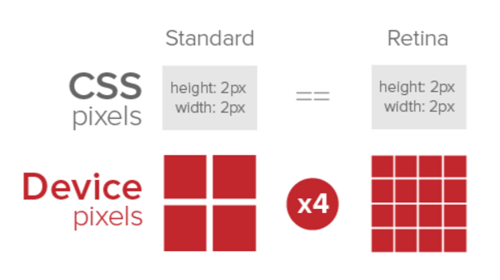
{ } Quick aside about units

Slide 76
{ } ah-em
em refers to the height of the letter 'm' of the font being used
This unit of measurement is a description of the relative size between this element and its parent
So h2 { font-size: 2em; } means the heading is 2 times as big as the letter 'm' of the default font in your html document

Slide 77
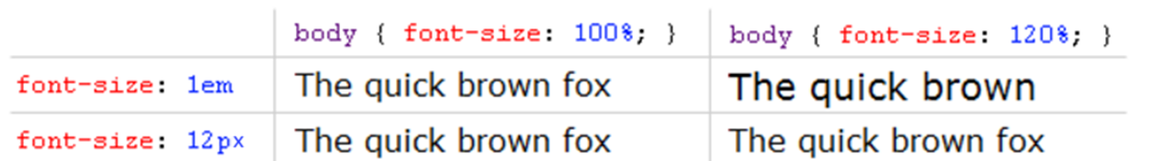
{ } That wasn’t quick
Because em is relative, that means that if the parent’s font size is increased, the children will get bigger too.

Slide 78
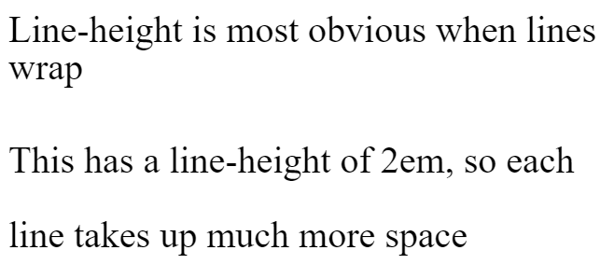
{ } Common font Properties
line-height: the height of a line
The value is a number representing the height of one line in ems (em) or pixels (px)
similar to leading in typography
p { line-height: 1.4em; }
Notes:
Website live example

Slide 79

{ } font transform
text-transform: changes font casing. Can be uppercase (all caps), lowercase, or capitalize (first letter of all words capitalized)
letter-spacing: change word tracking by specifying the space between letters in ems (em) or pixels (px)
p { font-family: Arial;
text-transform: uppercase;
letter-spacing: 2.4px;
}

Slide 80
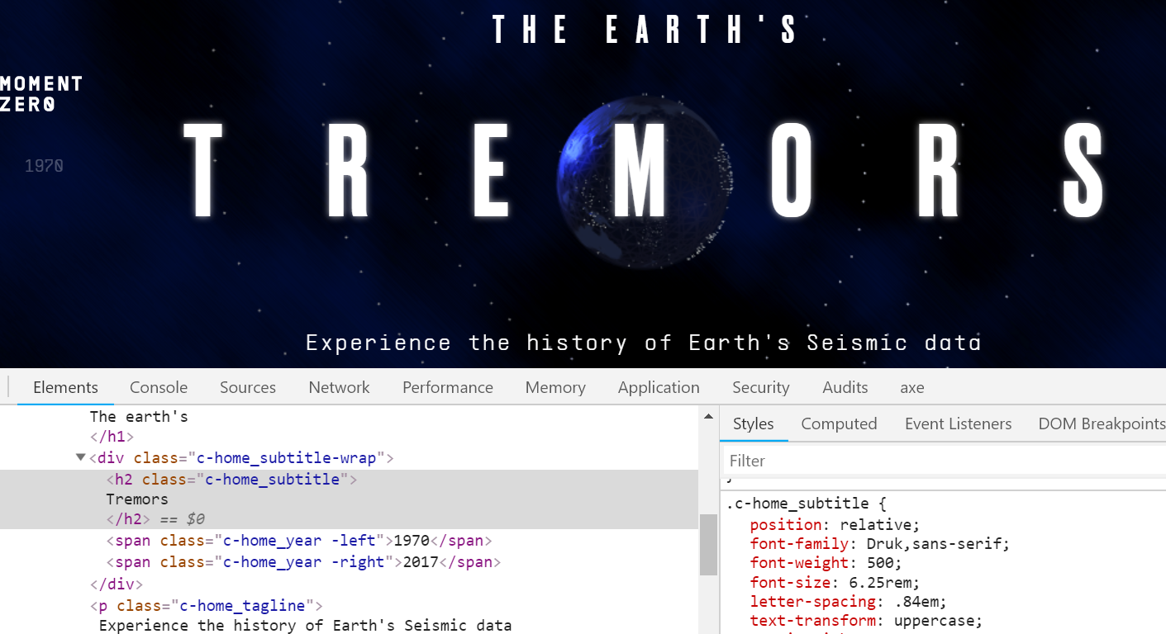
{ } font transform
From moment-zero.com

Slide 81
{ } Colors
color: changes the color of text
background-color: sets the background color of an element
Color value can be a name, HEX, RGB, or RGBA
Name: white
Hex: #ffffff
• RGB: rgb(255, 255, 255)
• RGBA: rgba(255, 255, 255, 0.8)
Notes:
256?

Slide 82

{ } Color examples
p { color: black;
}
p {
color: #fff; background-color: #000;
font-family: Impact, sans-serif;
}
p { background-color: rgb(0, 0, 0);
}
Notes:
256?

Slide 83
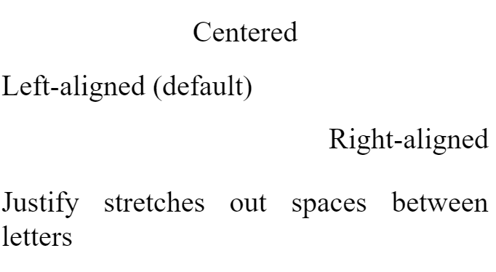
{ } Text-align
You can change the alignment of text using the
text-align property.
Values:
center
left
right
justify
h1 { text-align: center; }

Slide 84
{ } states in CSS
{ } states in CSS
CSS also allows you to apply styles based on the state of an element
Being hovered over with a mouse
Gaining focus via tabbing or clicking
This is known as a CSS pseudo-class (because it doesn’t really exist)
Whenever you see a : in a selector, that style will only apply to elements that are in that state

Slide 85
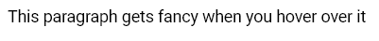
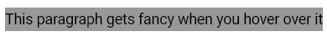

{ } Pseudo ex-psample
{ } pseudo ex-psample
p:hover { background-color: #999; }

Slide 86




{ } link states
{ } link states
Links have two additional states
:visited only applies once the user has viewed the page that is being linked to
:link only applies to unvisited pages
a:link
a:visited
a:hover
a:active

Slide 87
{ } four link states
{ } link states
a { color: blue; }
a:visited { color: gray; }
a:hover {color: purple; }
a:active { color: yellow; }
Let’s inspect a live demo of how this looks

Slide 88
PRACTICE TIME!

Slide 89
Practice
Add a <style></style> section in the <head> on your page
Make some style changes using CSS
Consider changing font color, font family, font size, text alignment, and background color
Make something change when hovered

Slide 90
HOMEWORK
For most of the class, we will be updating the same website.
So make sure the site you made today is something you will be interested in working on for the next few weeks!
If not, start a new project using what you learned today

Slide 91

“HOMEWORK”
Practice!
Next time you see a cool website, inspect how they did it
If you have questions during the week, feel free to email me at beckjohnson@gmail.com
Optional: read chapters 6-7 of HTML and CSS: Design and Build Websites

